Slide 1
NLP & GPT

Slide 2




Shameless Plug #1

Slide 3


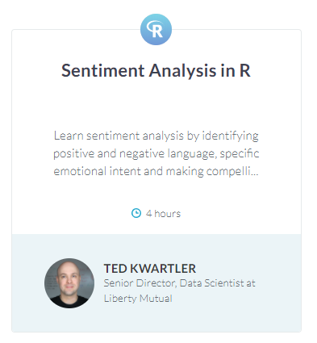
Shameless Plug #2

Slide 4
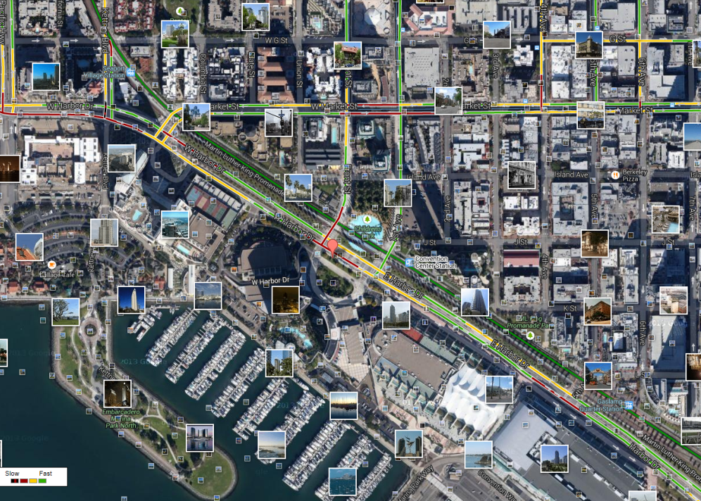
What is Text Mining?
Before Text Mining
Extract new insights from text
Let’s you drink from a fire hose of information
Language is hard; many unsolved problems
Unstructured
Expression is individualistic
Multi-language/cultural implications

Slide 5
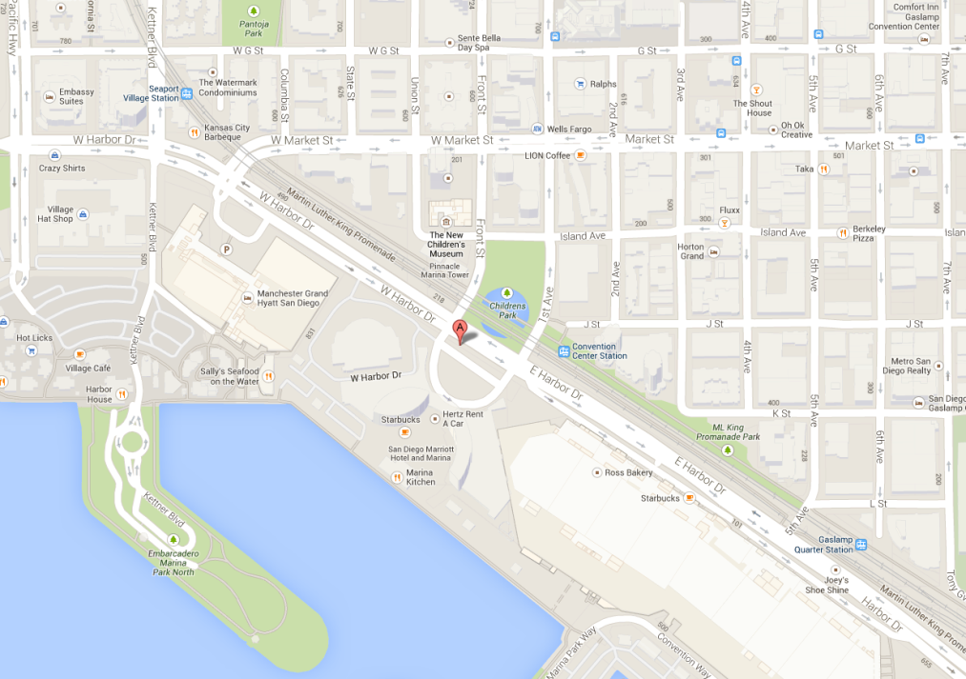
What is Text Mining?
After Text Mining
Extract new insights from text
Let’s you drink from a fire hose of information
Language is hard; many unsolved problems
Unstructured
Expression is individualistic
Multi-language/cultural implications

Slide 6
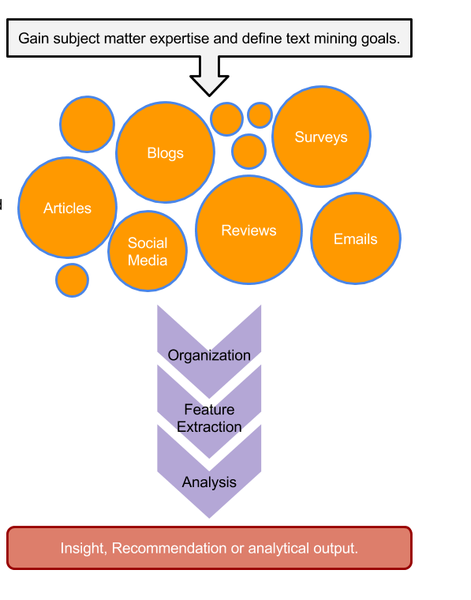
TM Project Workflow
Unorganized State
Natural Language Processing & Analysis
Organized State

Slide 7
Text Mining Workflow
Problem Definition
Identify Text Sources
Text Organization
Feature Extraction
Analytics
Reach Insight or Recommendation

Slide 8
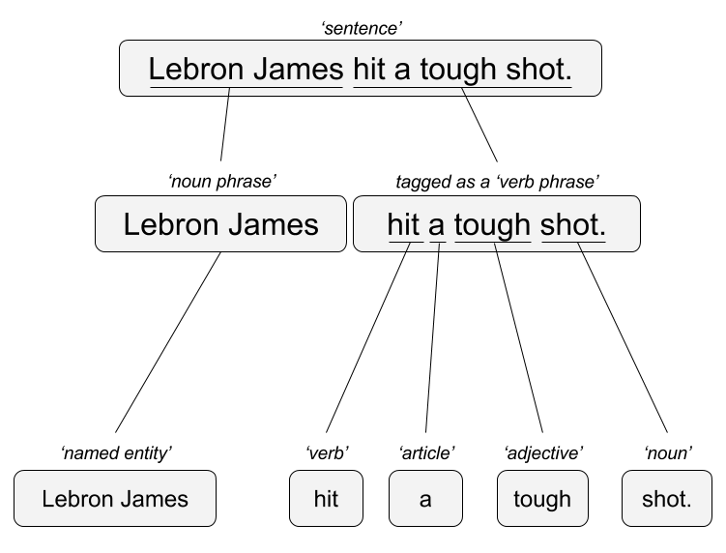

Two Popular Approaches – OLD SCHOOL!
“Lebron James hit a tough shot.”
Syntactic Parsing
Bag of Words
Lebron
a
James
hit
tough
shot

Slide 9
GPT Glossary
GPT - GPT stands for Generative Pre-trained Transformer
Word Embedding – library(text2vec) representations of words, phrases and documents as vectors of real numbers. It is a way of representing words and phrases as numerical values that can be used in machine learning algorithms. Word embeddings capture the context of words in a given corpus, allowing machines to understand the meaning of words in relation to each other.
RNN– library(keras) library(MXNet)?, library(rnn) Recurrent neural network processes sequential data. As data passes through the neural network previous inputs are “remembered” and inform the next prediction. This differs from “feed forward” networks.
Language Transformers– library(transformer) convert natural language into another form of language. It can be used to translate text from one language to another, or to convert text into a different format such as HTML or a description into a coding language.
Because of the size of the data, and speed, you wouldn’t build a GPT in R.

Slide 10
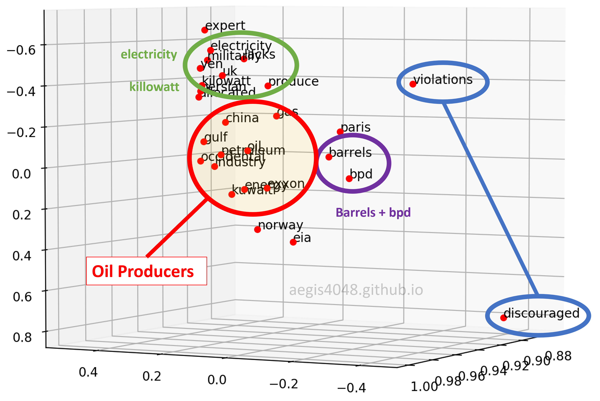
Vector/Pattern/DNN – Generative [GPT]
“Lebron James hit a tough shot.”
Vectors exist for the terms – vector for Lebron James, has commonalities with basketball, celebrity, & male in many dimensions simultaneously.

Slide 11
Generative [GPT]
The model uses the word embeddings, recurrent neural networks and language transformers to recognize words and phrase concepts that are then used for text generation.
User: Tell me about the oil industry.
Word Embedding: inquiry, personalization, oil, industry, business…
Response Construction:
+”sure”, [pattern to respond to inquiry]
+Add vector “sure” and generate next phrase: “here are some industry topics for you” [pattern to respond to inquiry, sure & personalization]
+Add vector “industry topics” and generate next phrase “The Gulf states…”
+Add Gulf states vector “produce petroleum”
+Add produce petroleum vector and generate next phrase “in barrels”.
Response to User: Sure Here are some industry topics. The Gulf states produce petroleum in barrels…

Slide 12


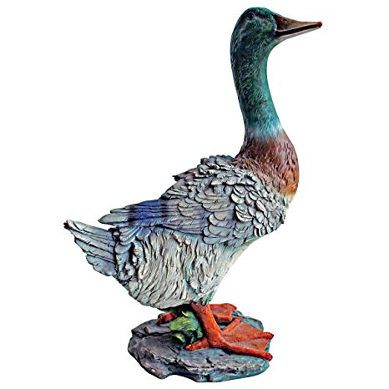

NLP/TM Challenges - Disambiguation
I made her duck.
I cooked waterfowl for her to eat.
I cooked waterfowl belonging to her.
I created the (clay?) duck and gave it to her.
Duck!!

Slide 13
NLP is hard!
Other Challenges
Examples
Compound words (tokenization) change meaning
Sarcasm
Cultural differences
“Bad” vs “not bad”
“I like it…NOT!”
“It’s wicked good” (in Boston)

Slide 14



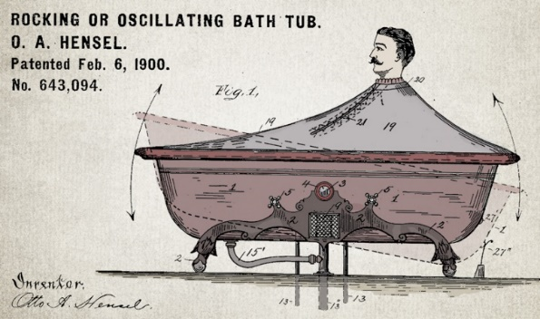

Channel affects language
🐝🔀🙏👁️👁️➡️🌎
Legal documents are verbose & technical.
“Be the change you want to see in the world.”
“kappa” indicates sarcasm, irony,
or a joke among online gamers.
Expression is context specific making analysis challenging.

Slide 15



Messenger affects language
Boomers 1946-1964
* Make a difference * Consensus/team * Experiment/try new things * “Imagine if…” * Save time * Features and benefits
Gen X 1965-1980
Best, finest, world-class
“You will benefit by…”
”This is in your best interest.”
Gen Y 1981-2000
Global citizen
Balance
Diversity
Community/connections
Beyond generation, other factors like socio-economic, gender & demographic makeup impact expression.
https://www.anneloehr.com/

Slide 16


Hipster expression is evolving rapidly due to technology.
“Thank you, next.”
“Woke”
“Cray”
“Gucci”
“Squad goal”
“Bible…”
“Adulting”
“Turnt”
“Hundo P”
“Trill”
“TFW”
Beyond generation, other factors like socio-economic, gender & demographic makeup impact expression.

Slide 17
Gen Y/Z expression is evolving rapidly due to technology.
“Thank you, next.” – moving on with positive connotation
“Woke” - The more woke one is, the more sympathetic & knowledgeable one is about a topic or type of person
“Cray” - crazy
“Gucci” – fine, good
“Squad goal” – friend group behavior
“Bible…” - what follows is TRUTH
“Adulting” – activities associated with growing up
“Turnt” – “turned up” i.e. really excited
“Hundo P” – agree “100%”
“Trill” – True & Real
“TFW” – “That Feeling When” to describe an emotion
Beyond generation, other factors like socio-economic, gender & demographic makeup impact expression.

Slide 18




Audience affects language
And we all context switch based on who were are speaking too.

Slide 19
Rather than build GPTs w/R, let’s use openAI’s

Slide 20

What is an API?
“Application Program Interface”
Clearly defined methods of communication between various software components.

Slide 21
JSON- Javascript Object Notation
Similar to R but used to make interactive objects in web browsers.
Respond in XML or JSON
Ask a question

Slide 22


Your phone doesn’t have every map in the world.
“Your phone requests information from the maps API services to render the information.

Slide 23
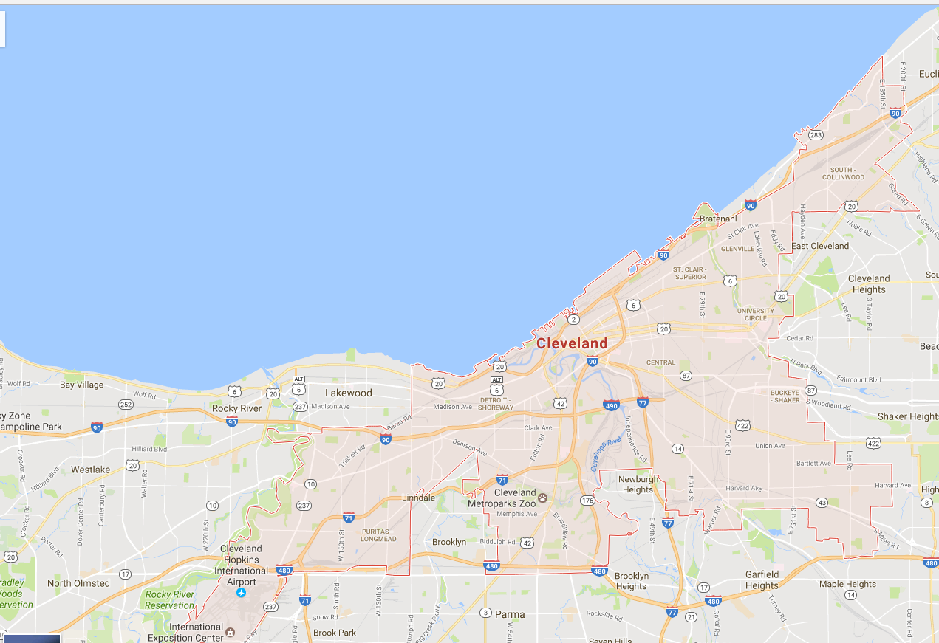
Your phone doesn’t have every map in the world.
www.google.com/maps/place/Cleveland,+OH/@41.4951143,-81.8462865,11z
Google Maps API Services include
Geocoding
Base map “tiles”
Basic Geographic Info

Slide 24
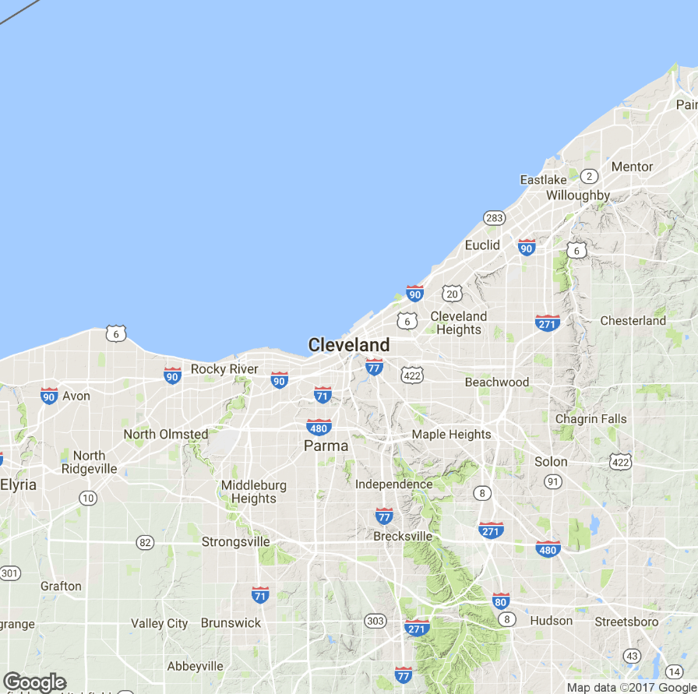
APIs are behind many of the sites you use everyday.
Static Map API
Static images are loaded as tiles underneath allowing you to scroll and navigate in your browser.

Slide 25
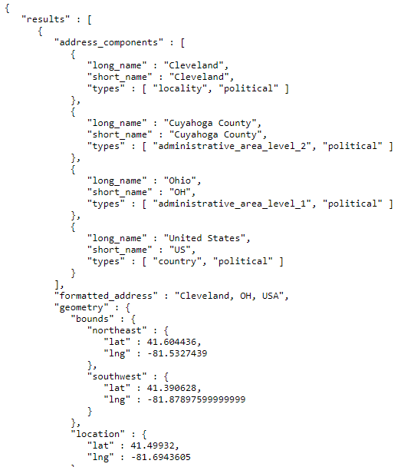
APIs are behind many of the sites you use everyday.
JSON Information API
On top of the tiles, more information is needed including the geo-political information and coordinates for the “bounding box”

Slide 26
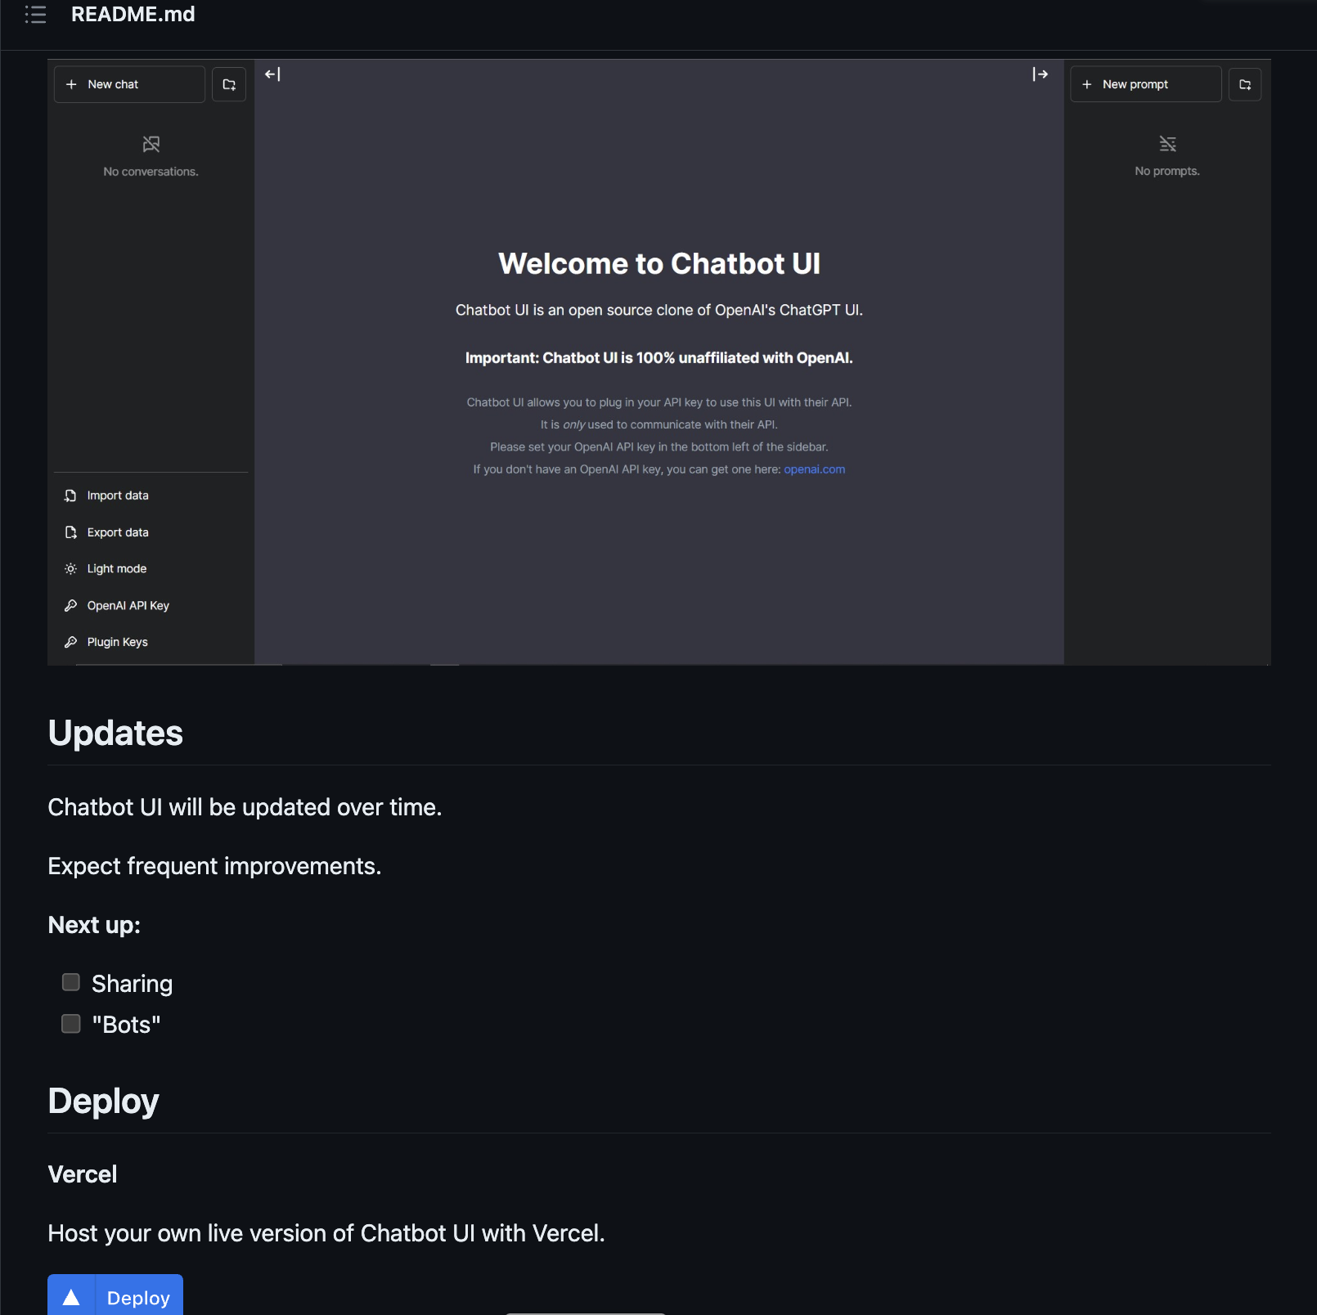
https://github.com/mckaywrigley/chatbot-ui
Cheaper as API
No “busy” downtime

Slide 27
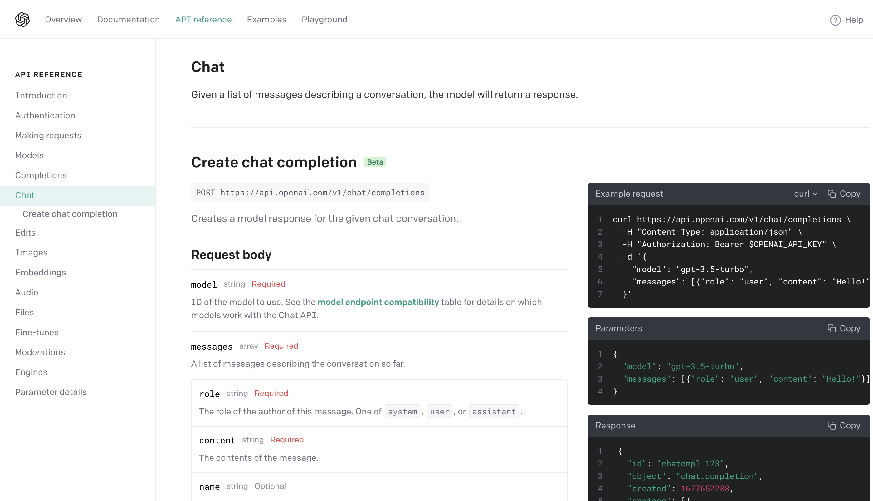
Let’s explore openAI’s API for GPT
We have more control over the response characteristics with API parameters:
https://platform.openai.com/docs/api-reference/completions/create

Slide 28
A_exampleOpenAPI.R

Slide 29
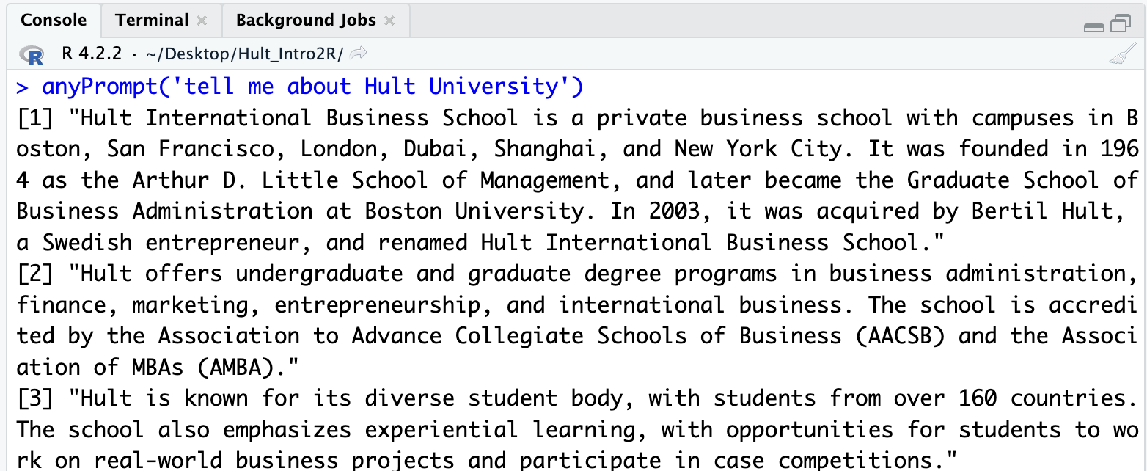
We can build support functions for our coding
Just stay in R-Studio and ask questions!
Open B_anyPromptOpenAI.R

Slide 30
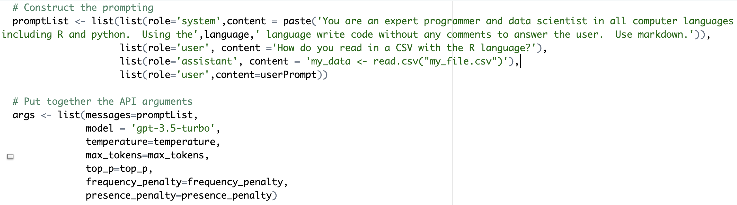
Let’s get something more specific to help our coding.
Open C_codeHelperOpenAI.R

Slide 31
You can load these easily anytime you’re coding for the cases to help you if needed!
Upside:
This technology is a productivity boost.
No computer scientist or data scientist knows everything! Why not use this to help you?
Downside:
What exactly does this code do?
What is this error (currently it often gets close but isn’t perfect so expertise is often still needed)?
Expectations for output and productivity will grow.

Slide 32
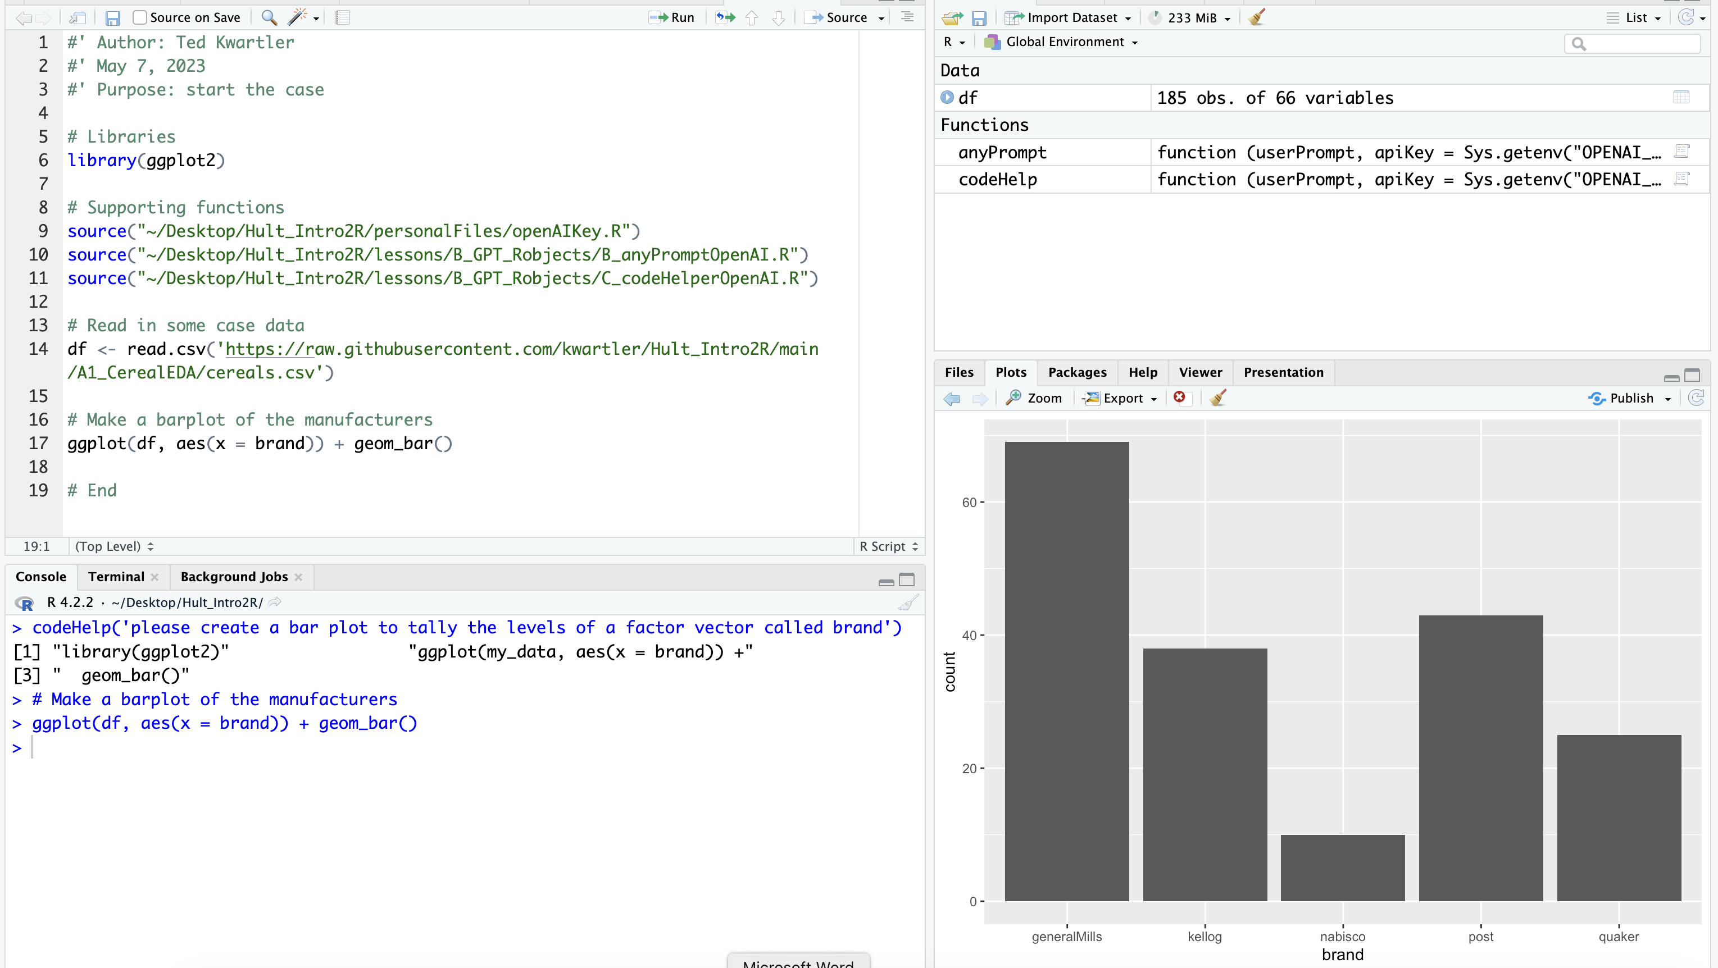
In this class you can use this tool but my expectations are high.

Slide 33
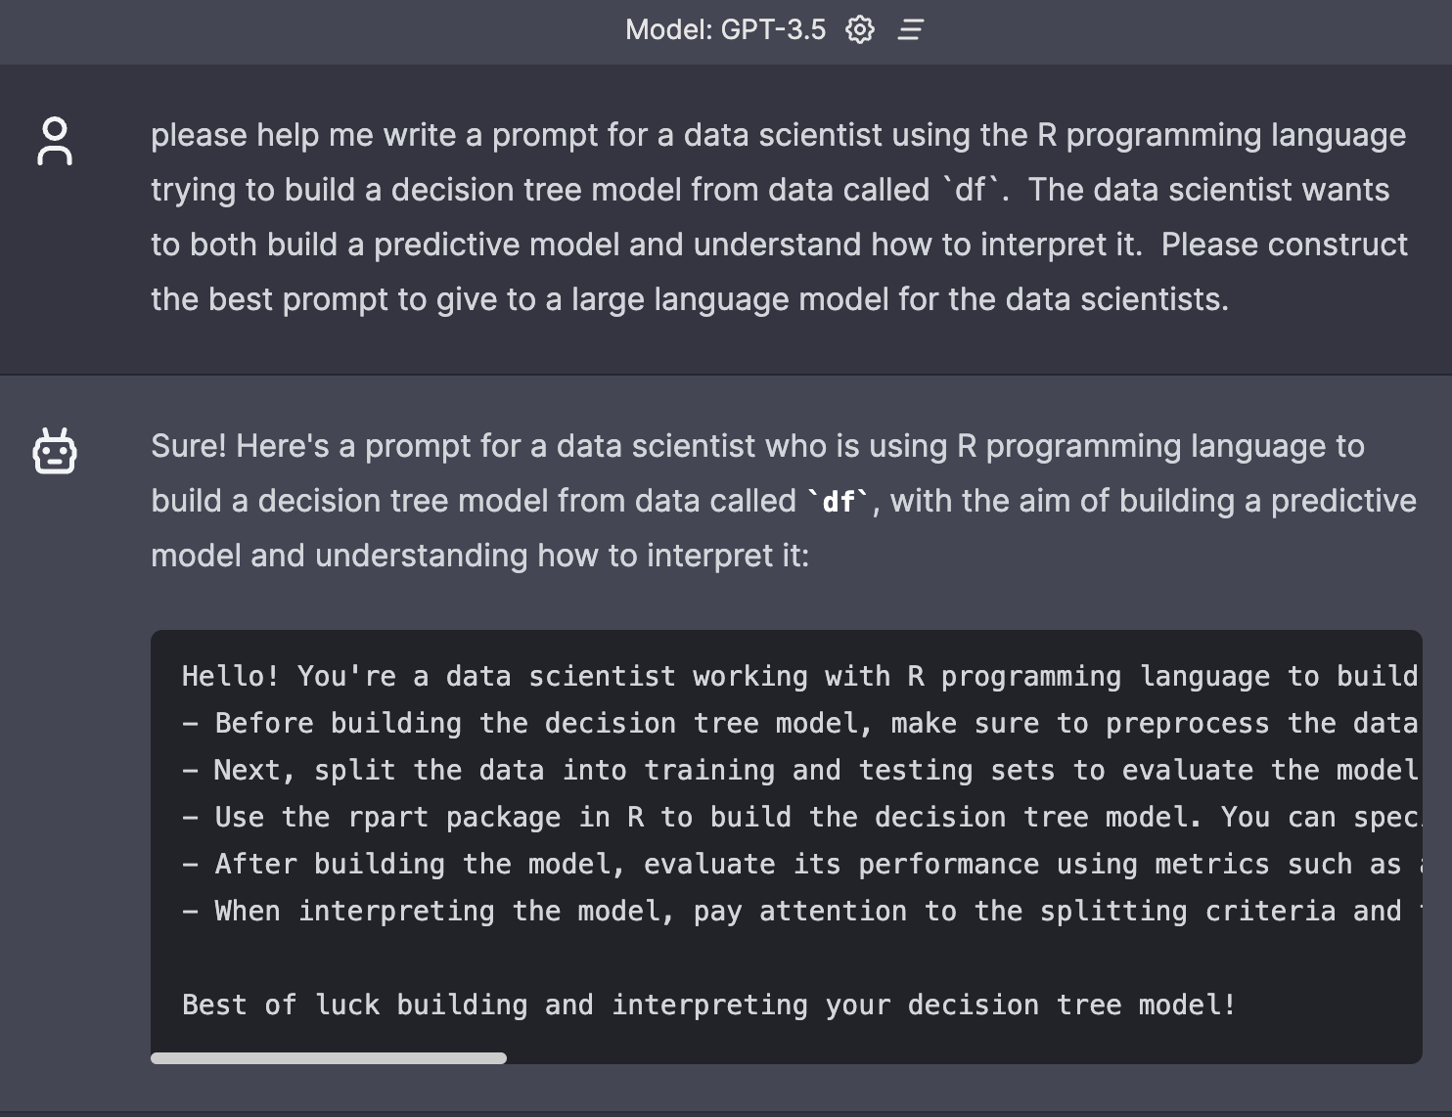
As a tool, you have to learn how to extract the best from it.
- You can ask it to help you improve your prompt.

Slide 34
As a tool, you have to learn how to extract the best from it.
- You can ask it to help you improve your prompt.

Slide 35
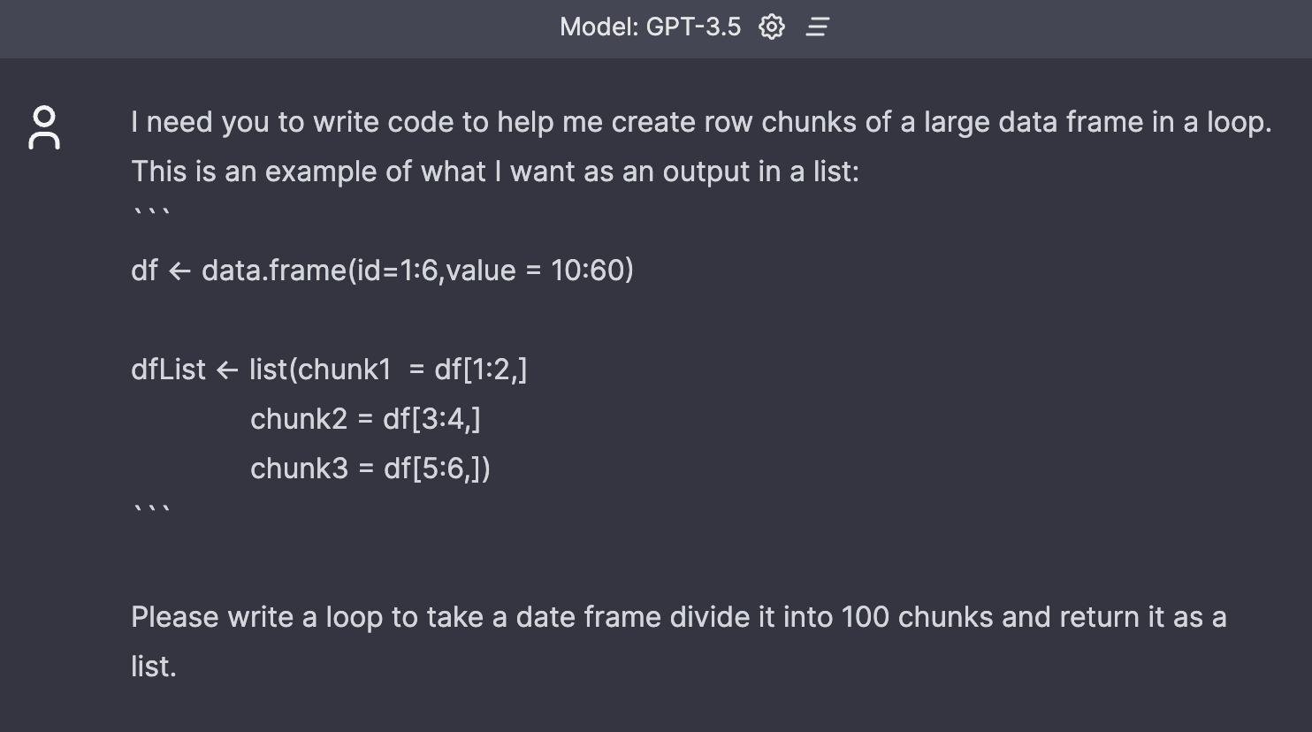
Best Practice: Give it examples

Slide 36
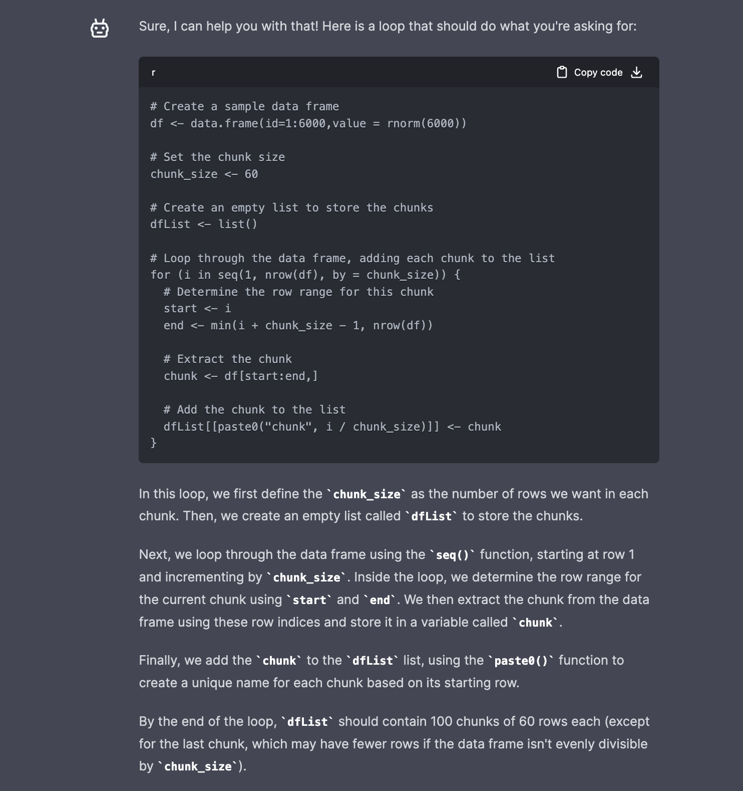

Slide 37
Other best practices – use those 4096 tokens!
OpenAI’s Docs:
Complex Responses may hit the limit and get cutoff
1 token = ~4 chars in English
1 token = ~¾ words
100 tokens = ~75 words
Or
1-2 sentence = ~30 tokens
1 paragraph = ~100 tokens
1,500 words = ~2048 tokens
Please continue.
Please continue ```

Slide 38
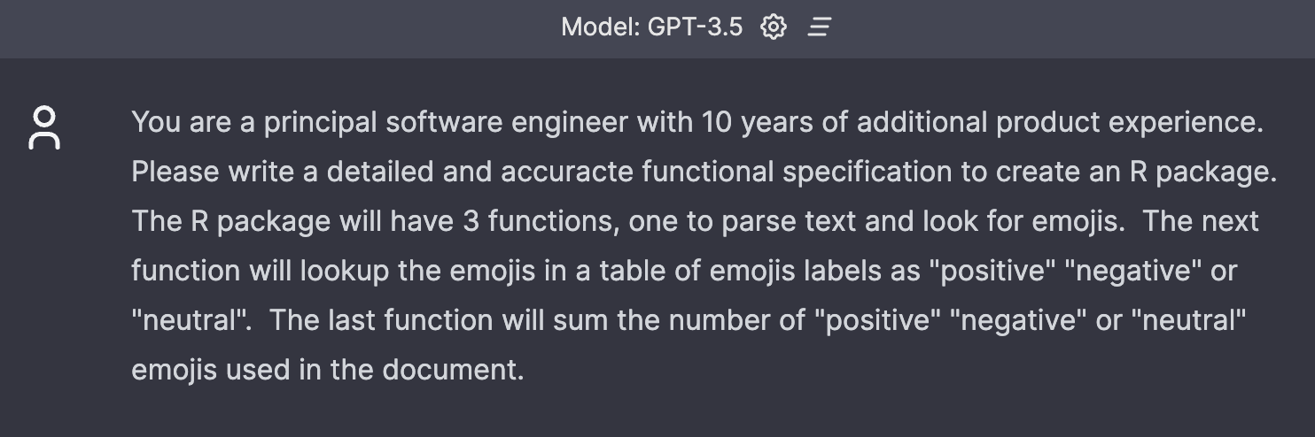
Because it has “short term memory”, ask it for functional specifications first for complex workflows

Slide 39
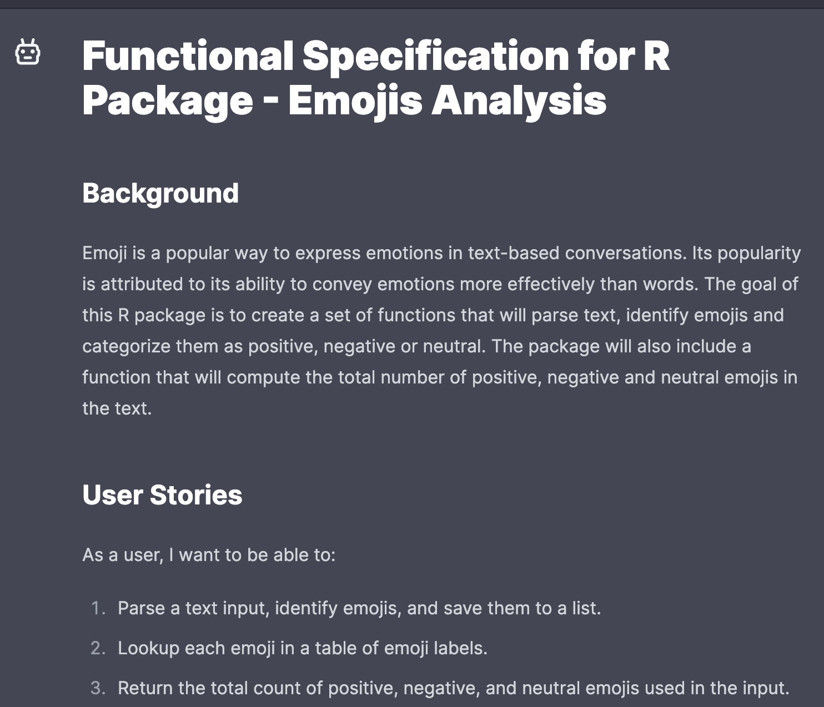
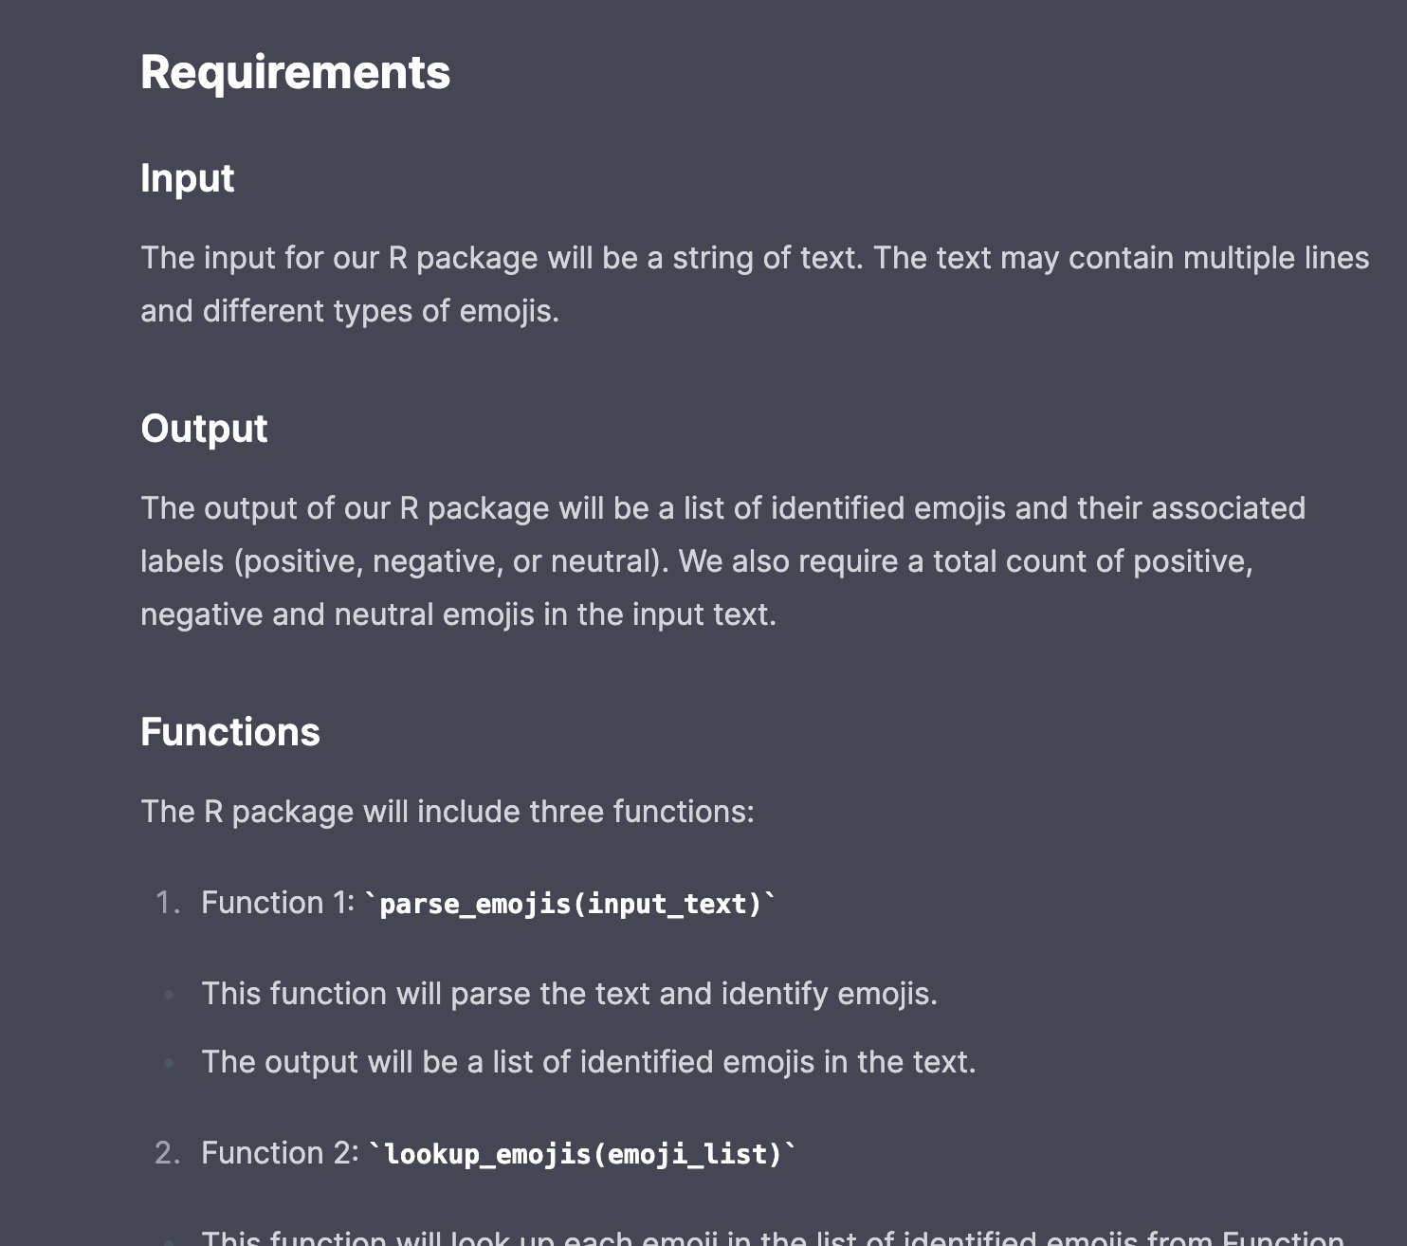

Slide 40
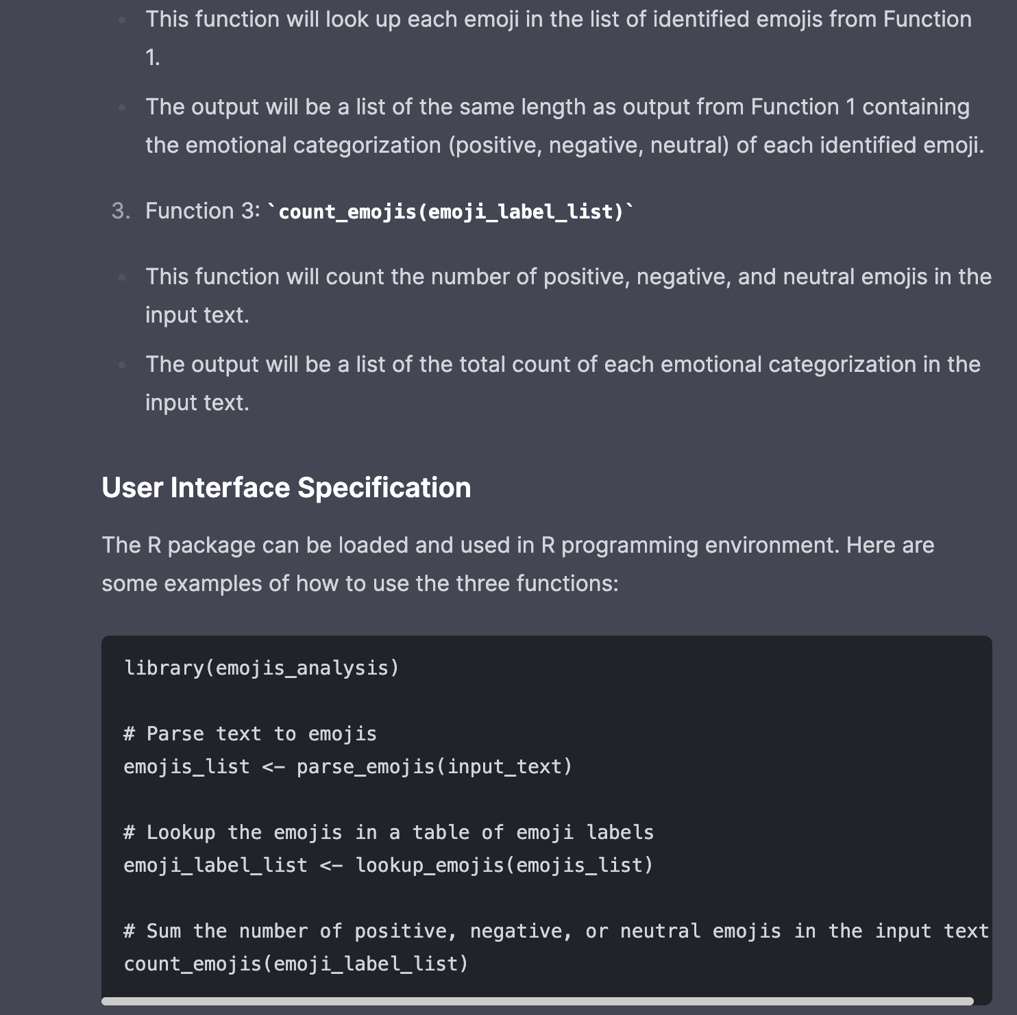
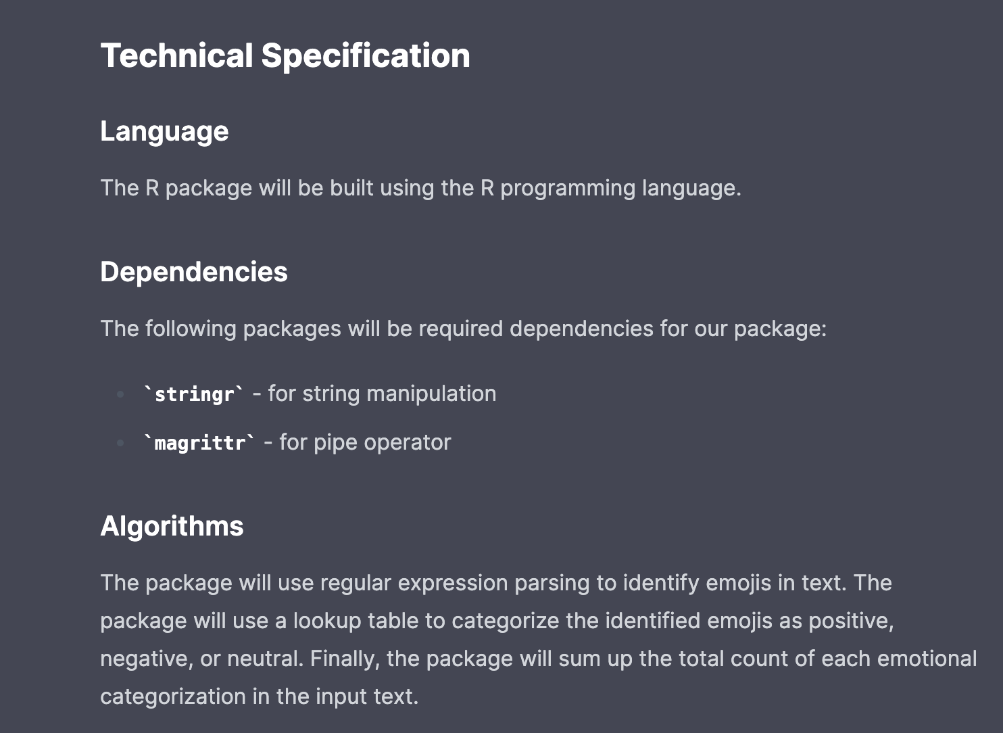

Slide 41
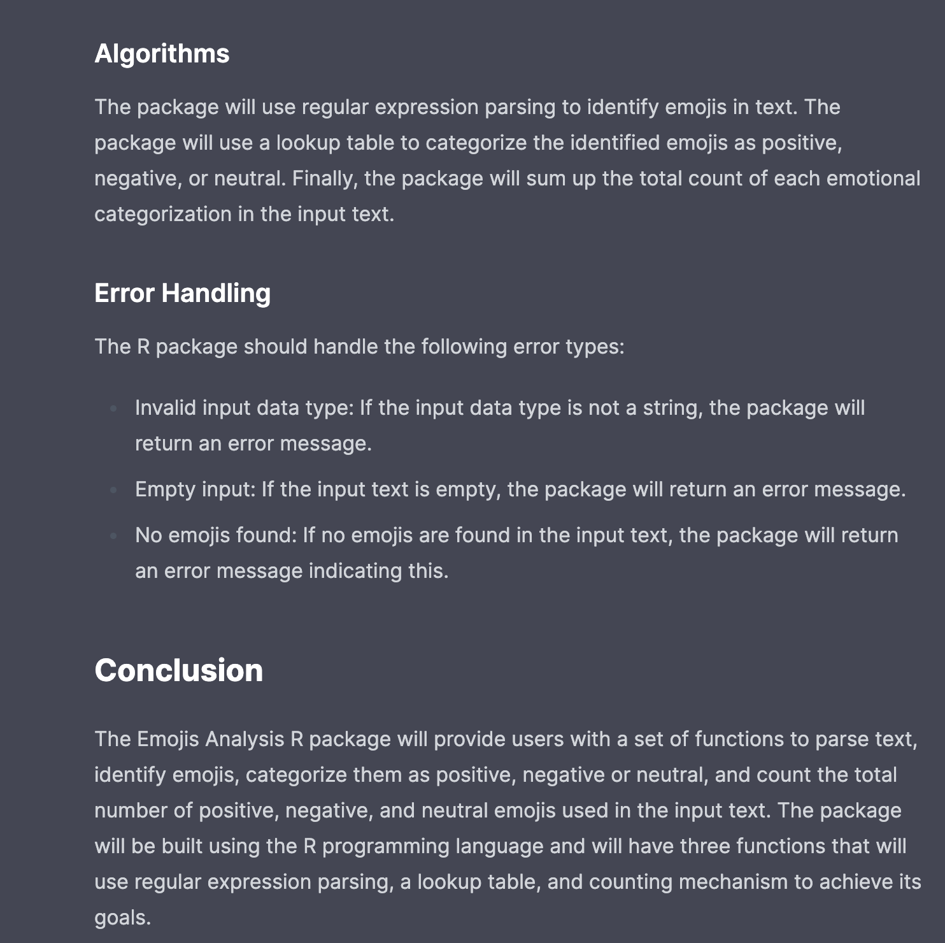

Slide 42
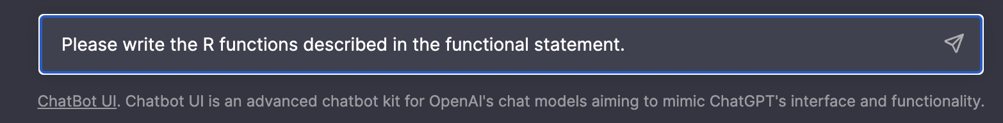

Slide 43
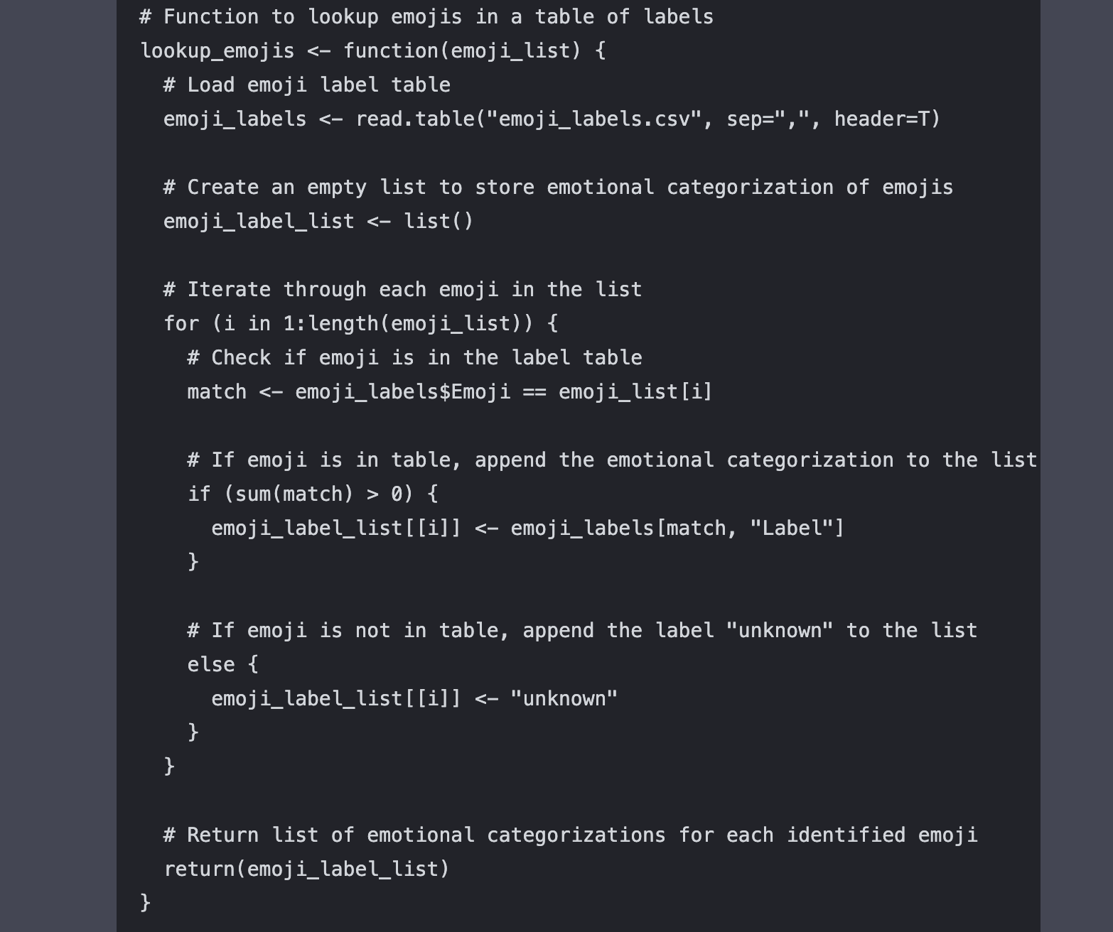
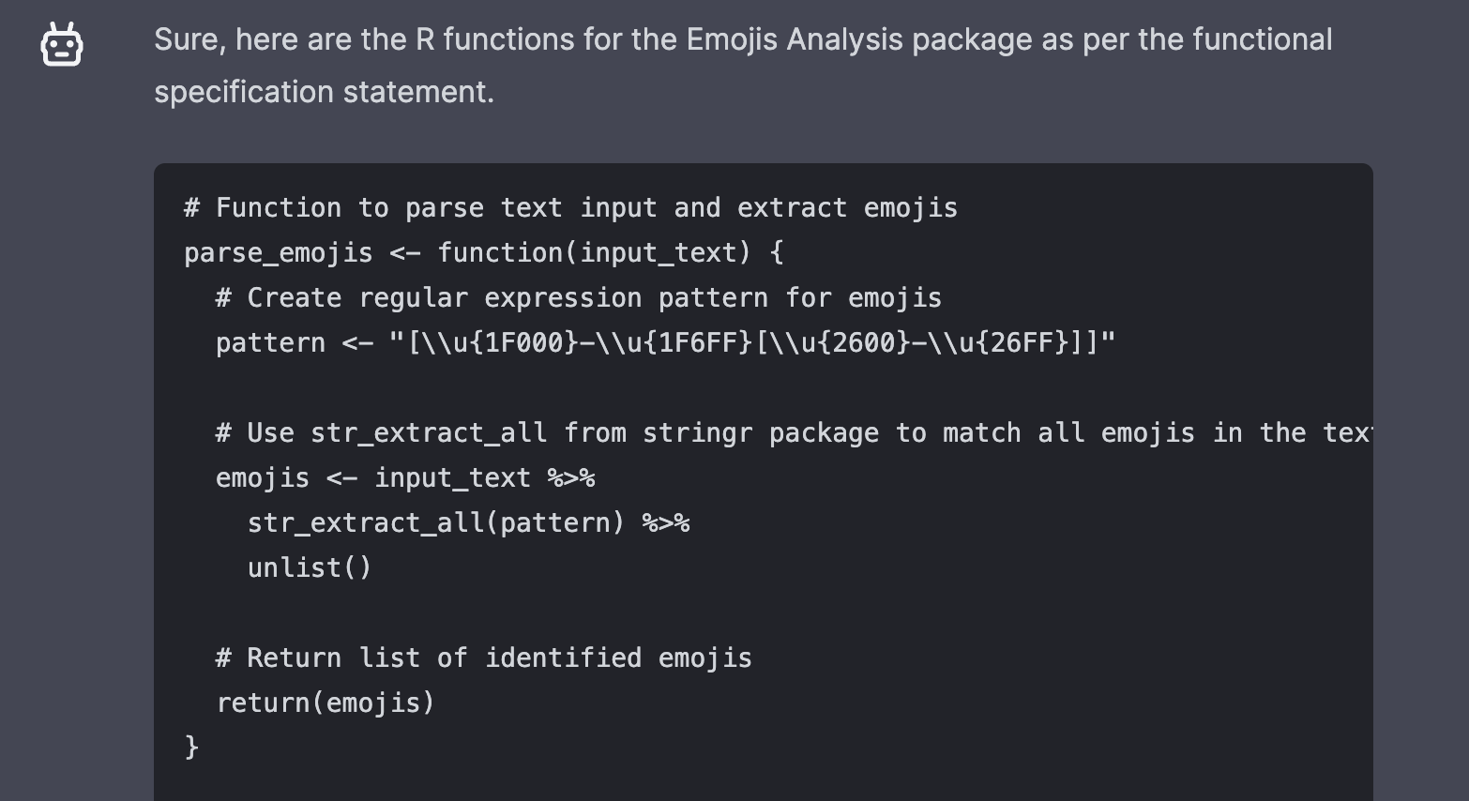

Slide 44
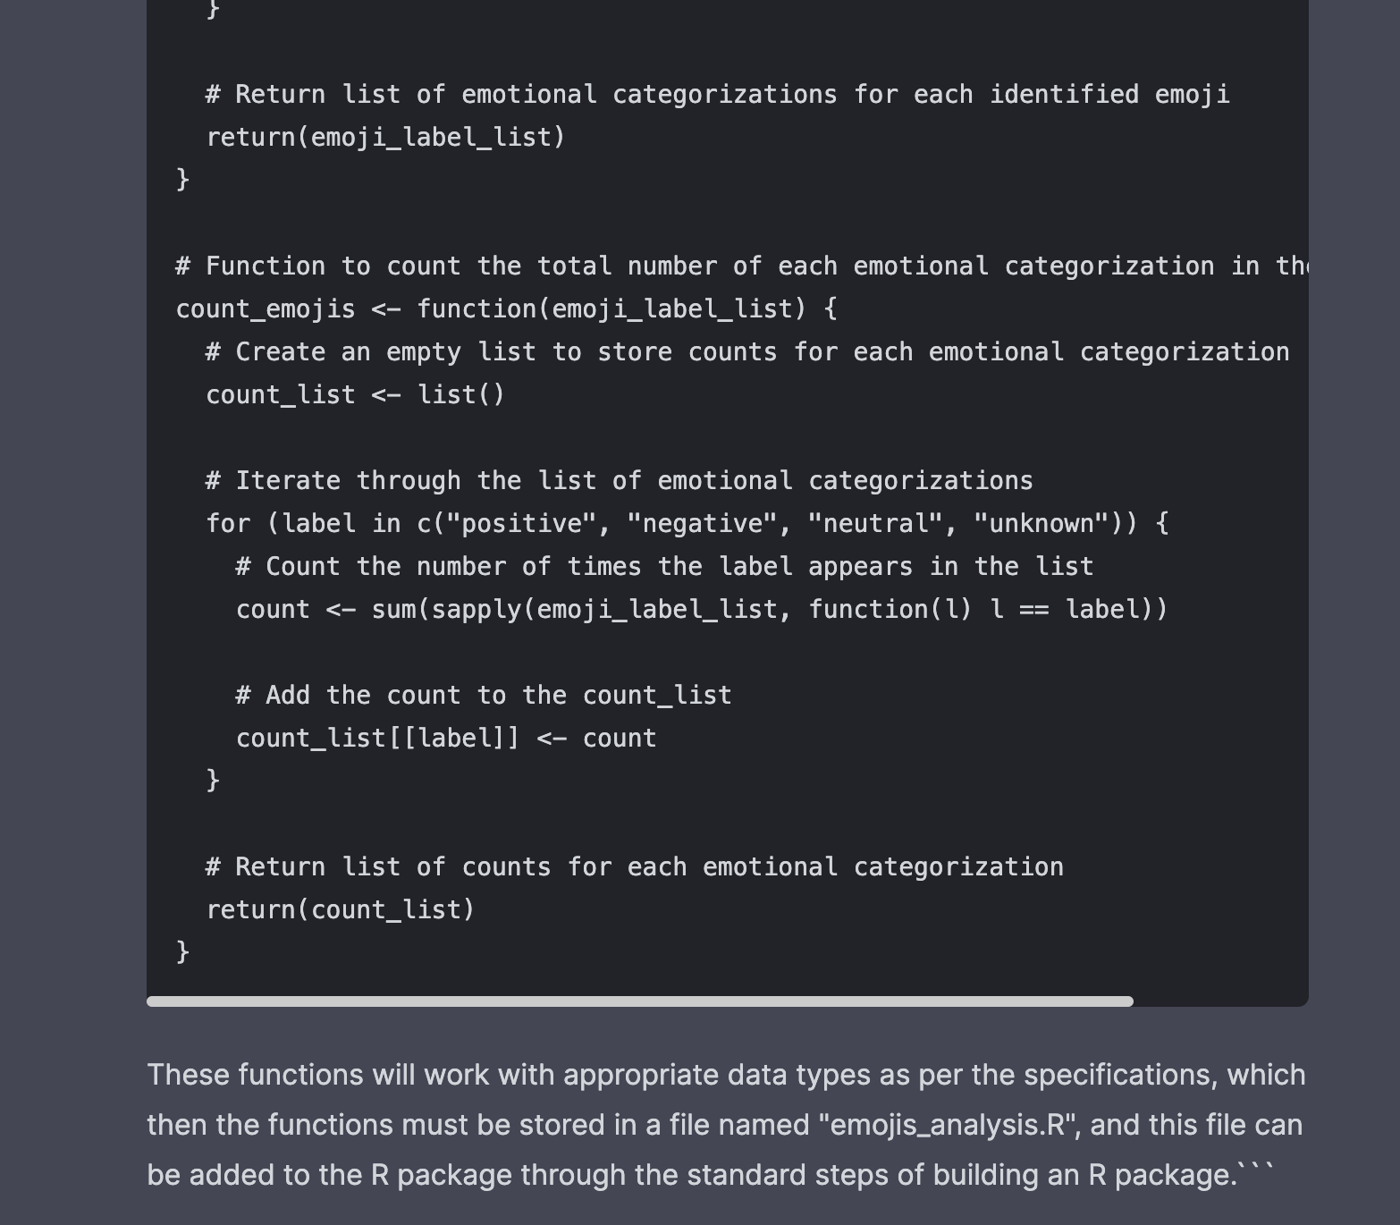

Slide 45
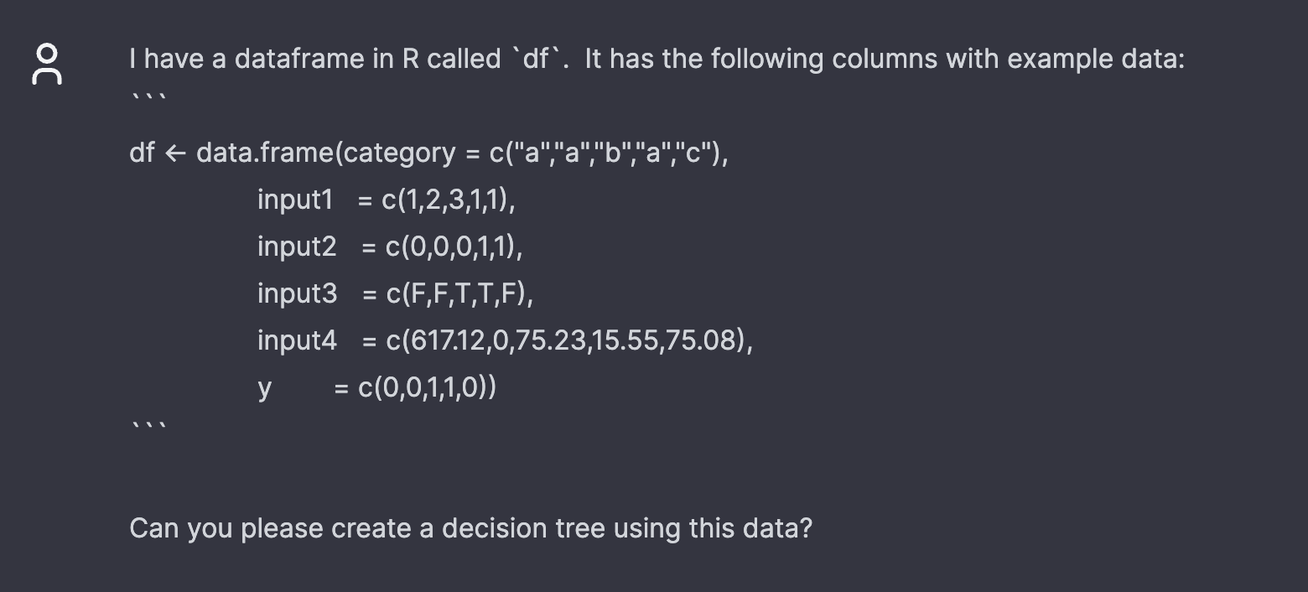
Let’s examine a GPT output and understand its value through critique.

Slide 46
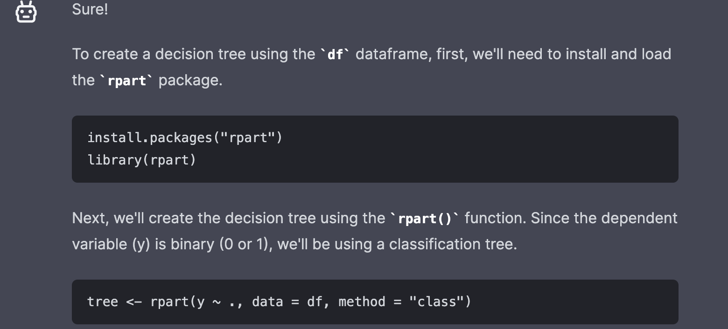

Slide 47
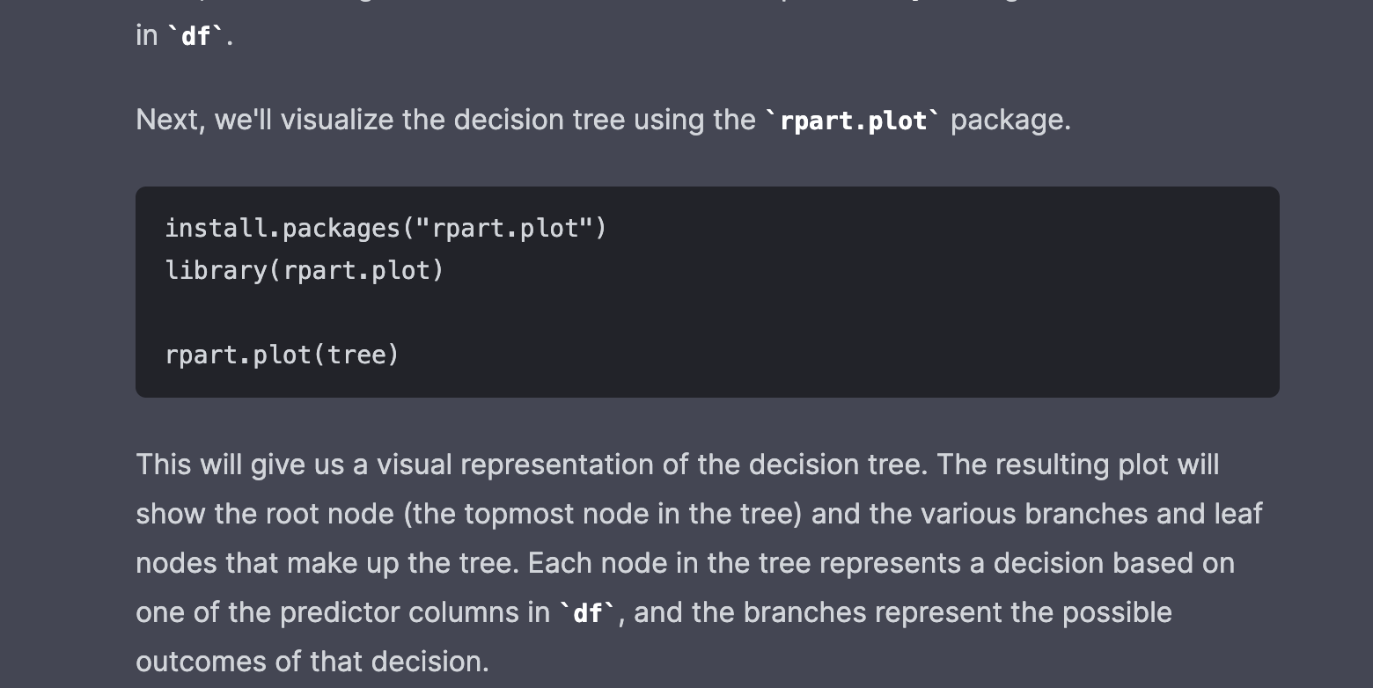

Slide 48
